Slide 1
Page Replacement
Upon page fault
Find a free page frame.
Fetch disk block into page frame.
When disk read finishes, add VM mapping for the page (change page table entries)
Find a free page frame
If there is a free page frame, use it
Otherwise,
Select a page to be replaced (page replacement algorithm),
Write the selected page to the disk if necessary

Slide 2
Issue: Eviction
Goal: kick out the page that’s least useful
Problem: how do you determine least useful?
Different heuristics
Better not to choose a page that will be used immediately, frequently
probably need to be brought back in soon
Clean pages (not modified)
A dirty/Modified bit for each page frame
Need to write back to disk if a “dirty” page is evicted

Slide 3
Optimal Page Replacement Algorithm
Replace a page whose next use will occur farthest in the future
Should have least number of page faults
The only problem is
Unrealizable
Why?
Needs a time machine

Slide 4
Not Recently Used Page Replacement Algorithm
Each page has Reference bit, Modified bit
bits are set when page is referenced, modified
At a certain fixed time interval, the clock interrupt triggers and clears the referenced bit of all the pages
only pages referenced within the current clock interval are marked with a referenced bit

Slide 5
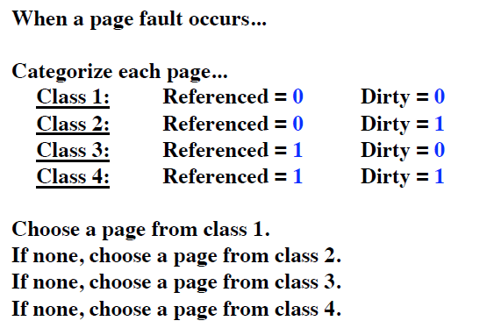
Not Recently Used Page Replacement Algorithm

Slide 6
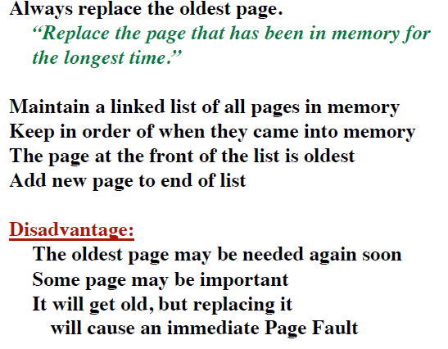
FIFO Page Replacement Algorithm

Slide 7
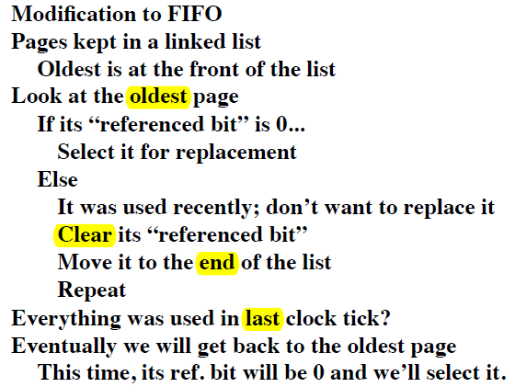
Second Chance Page Replacement Algorithm

Slide 8
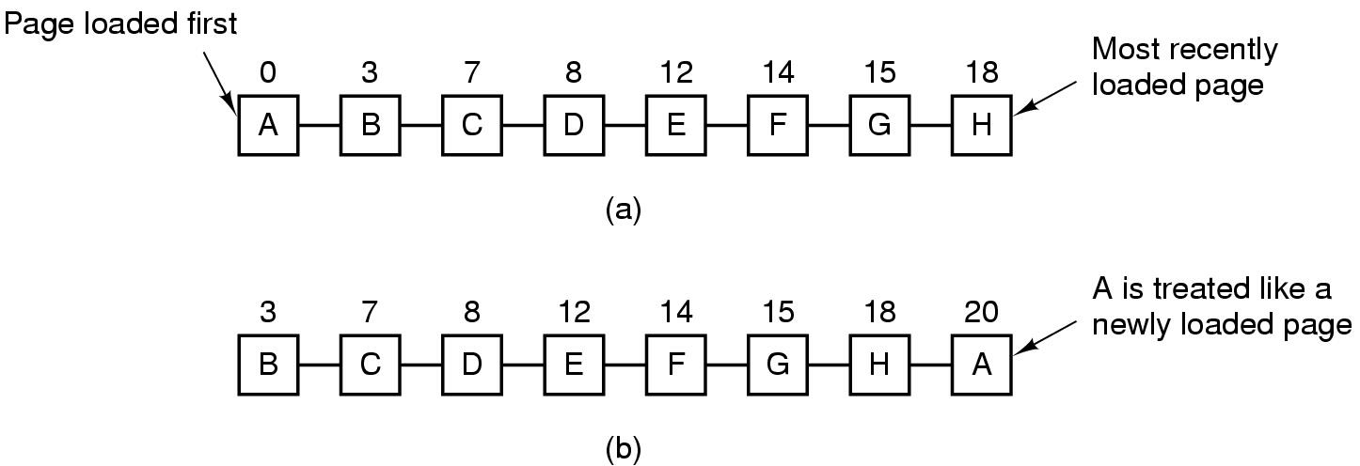
Second Chance Page Replacement Algorithm
Operation of a second chance
Page list if fault occurs at time 20, A has R bit set (numbers above pages are loading times)

Slide 9
The Clock Page Replacement Algorithm
Efficient implementation of Second-chance
pages don't have to be constantly pushed to the back of the list
keeps a circular list of pages in memory
the hand (iterator) points to
The oldest page (initially)
The last examined page

Slide 10
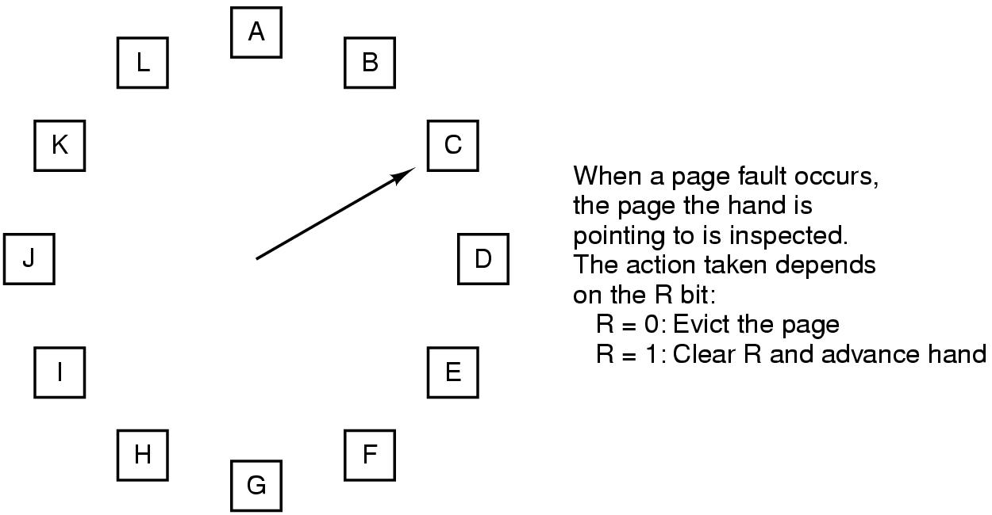
The Clock Page Replacement Algorithm
and the process is repeated until a page is replaced

Slide 11
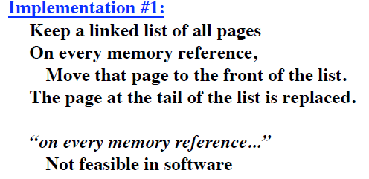
Least Recently Used (LRU)
Assume pages used recently will used again soon
throw out page that has been unused for longest time

Slide 12
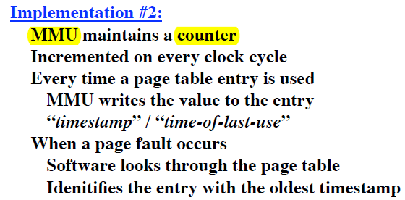
Least Recently Used (LRU)
Assume pages used recently will used again soon
throw out page that has been unused for longest time

Slide 13

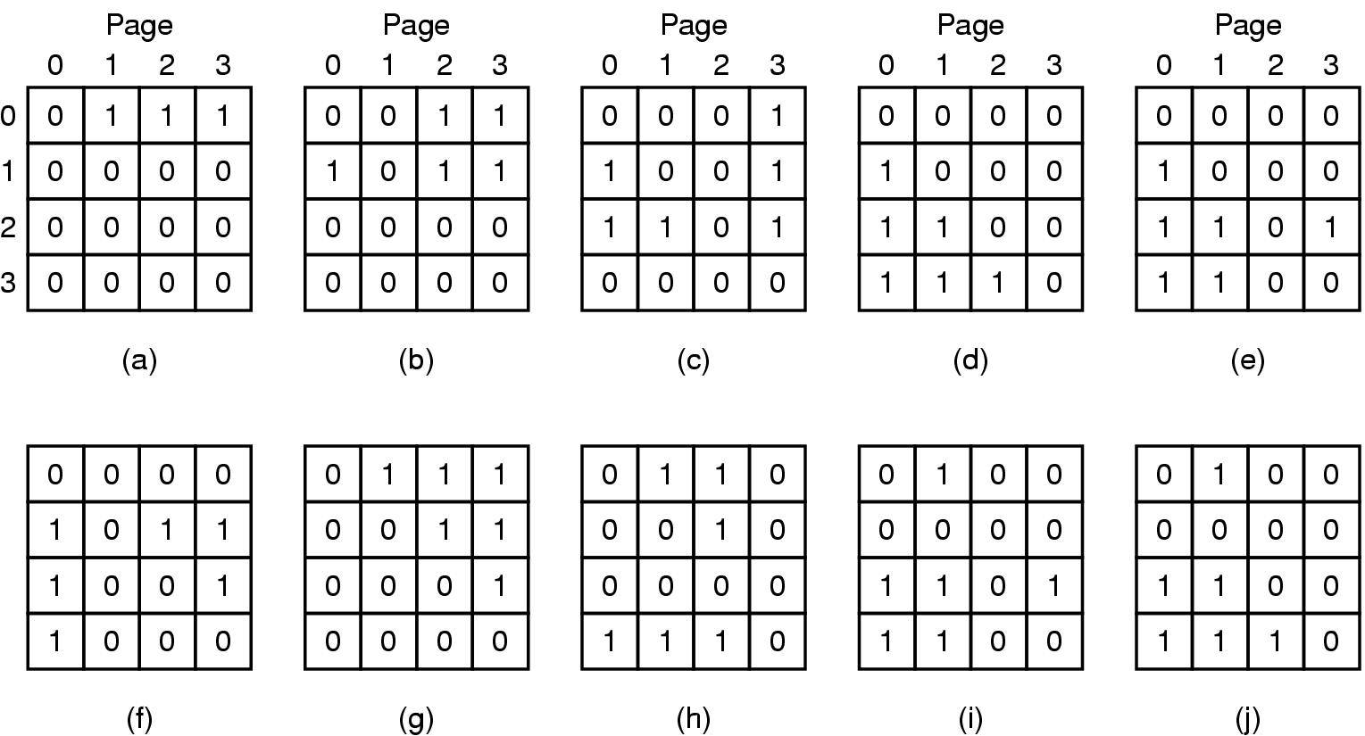
LRU using a matrix – pages referenced in order 0,1,2,3,2,1,0,3,2,3

Slide 14
Simulating LRU in Software
Not Frequently Used (NFU) Algorithm
Aging

Slide 15
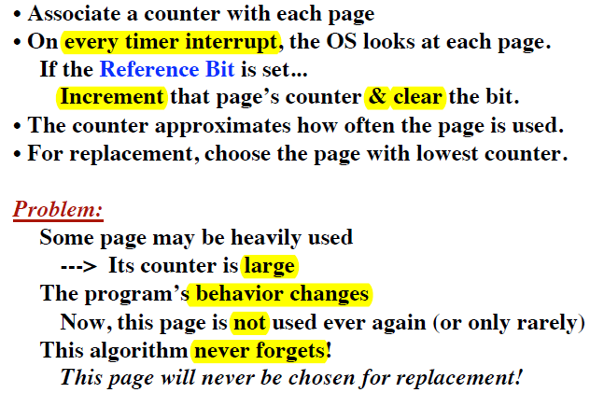
Not Frequently Used (NFU) Algorithm

Slide 16
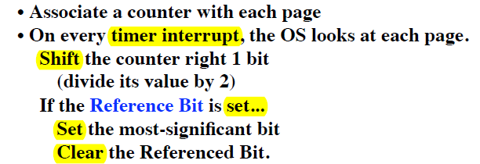
Aging
Modification of NFU to make it aware of the time span of use

Slide 17
Aging
For instance, if a page has referenced bits 1,0,0,1,1,0 in the past 6 clock ticks, its counter will look like this:
10000000,
01000000,
00100000,
10010000,
11001000,
01100100.
Page references closer to the present time have more impact than page references long ago

Slide 18
Aging
Difference with LRU
The exact reference time not known
Can recall limited past

